Slide 1
CodePath
Week 3
CS 4760 F18
Christopher Raley

Slide 2
Codepath Homework
Security Shepherd (Challenges 0-4)
No CTF

Slide 3
Cross-Site Scripting (XSS)
Clickjacking
HTML Tags
Topics
Week 3
Readings available on CodePath Course website

Slide 4
Cross-Site Scripting (XSS)
Ranked #3 security threat by OWASP
Majority of websites like to use JavaScript
Users can inject their own scripts if the input on websites are not properly sanitized
Another example of injection attack
Recall SQLi last week

Slide 5
Cross-Site Scripting (XSS)
Attackers can steal your cookies or other private data
Cookies here in this case will be like session ID’s
Can be any script injection, but most commonly Javascript
Majority of web applications use it

Slide 6
Cross-Site Scripting (XSS)
Persistent XSS
Originates from website’s database
Reflected XSS
Originates from client-side request
DOM-based XSS
Cross between persistent and reflected

Slide 7
Why is this relevant?

Slide 8
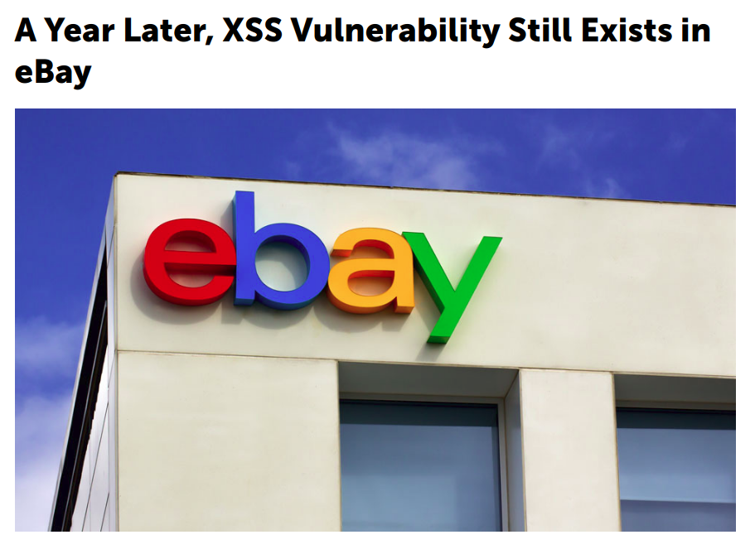

Slide 9
<SCRIPT>alert('XSS')</SCRIPT>
<IMG SRC="#" ONERROR="alert('XSS')"/>
<INPUT TYPE="BUTTON" ONCLICK="alert('XSS')"/>
<IFRAME SRC="javascript:alert('XSS');"></IFRAME>

Slide 10
Lab 3
XSS

